Slide 1
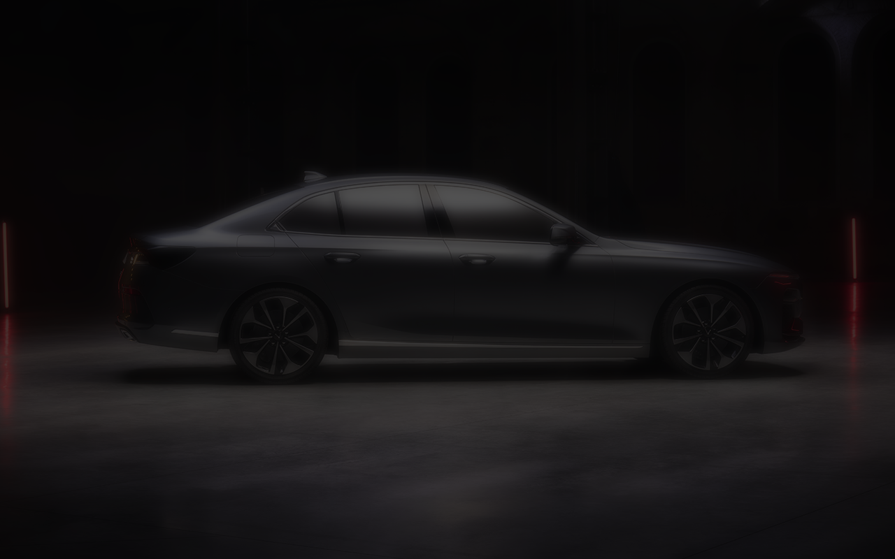

Automotive Capstone Project
Home Application in Car
Presenter: Nguyen Thanh Tam
Mentor: Pham Ba Thanh

Slide 2
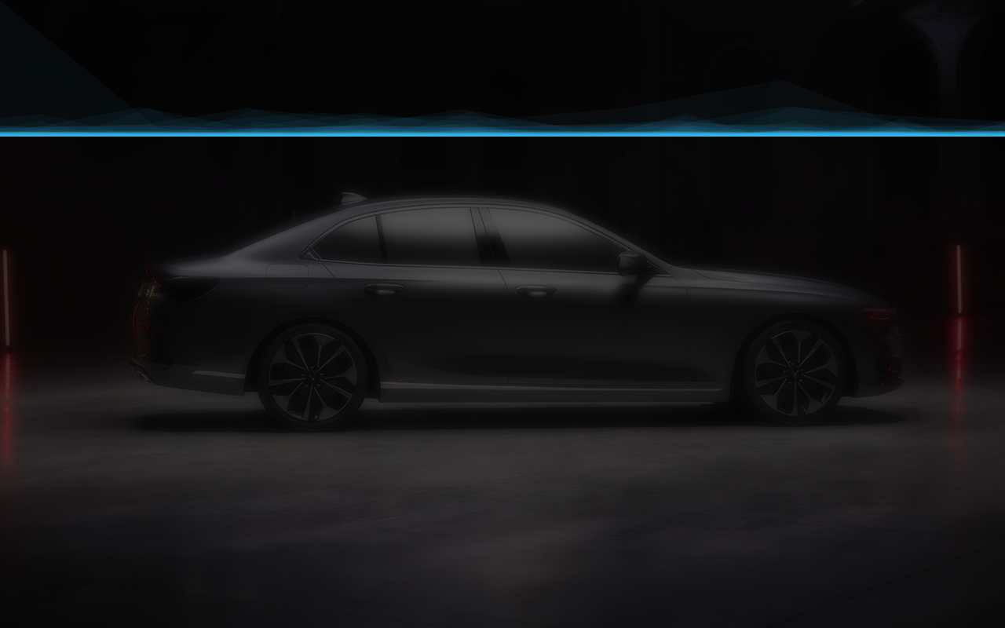
Glossary
Introduction
Software Requirement
Architecture Design
UI Design
Process Flow
Unit Test
Demo Application

Slide 3
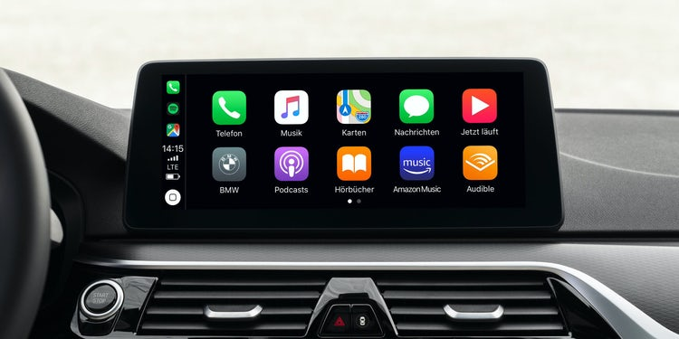
1. Introduction
Application name: Home Application for Automotive
Home Application is a first step to build an IVI for automotive application.
It shows what features the system has and it is the entrance of the features in the system.
Nowadays, there are many screens on a car: front screen for the driver, seat-back screen for the passenger. We will create the front screen for the driver here.

Slide 4
2. Software Requirement
Layout: Screen must be divide into 3 section areas:
+ Status Bar area display information about Date - Time of system.
+ Widget area display information of other application such as Climate, Map and Media.
+ Application Menu area display application list.
Display the Back button when open the other application.

Slide 5
2. Software Requirement
Application list is stored in xml file.
User can scroll application list when have more than 6 applications
Reorder application list.
Open the app or widget by clicking on it.
For more detail, please refer Home_SRS.pdf

Slide 6
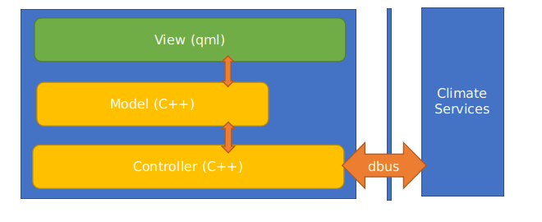
3. Architecture Design
View (qml): This is where the screens are managed, components built with qml and the resources of the screen building.
Model: As the data building for managing the state of the interface from C ++, it is the place to show the data for the state construction of the screen.
Controller: As part of processing, program control, and responsible for connecting to the 3rd services (specifically here is climate services).

Slide 7
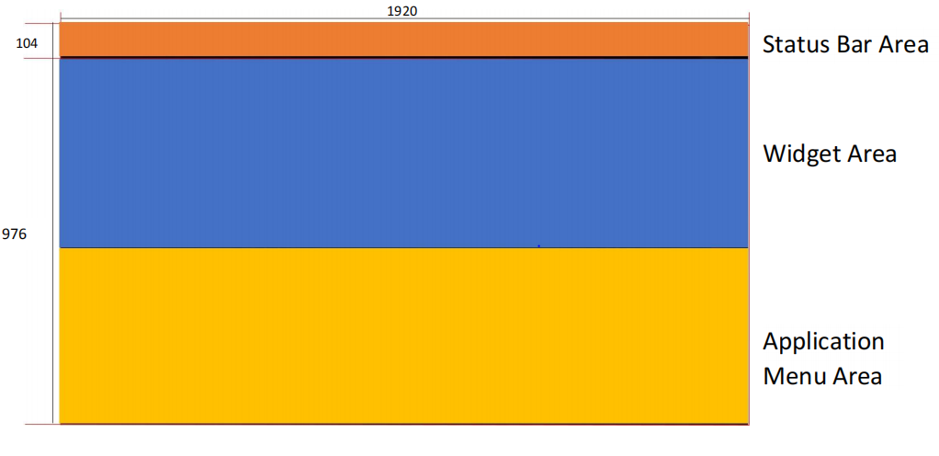
4. User Interface Design

Slide 8
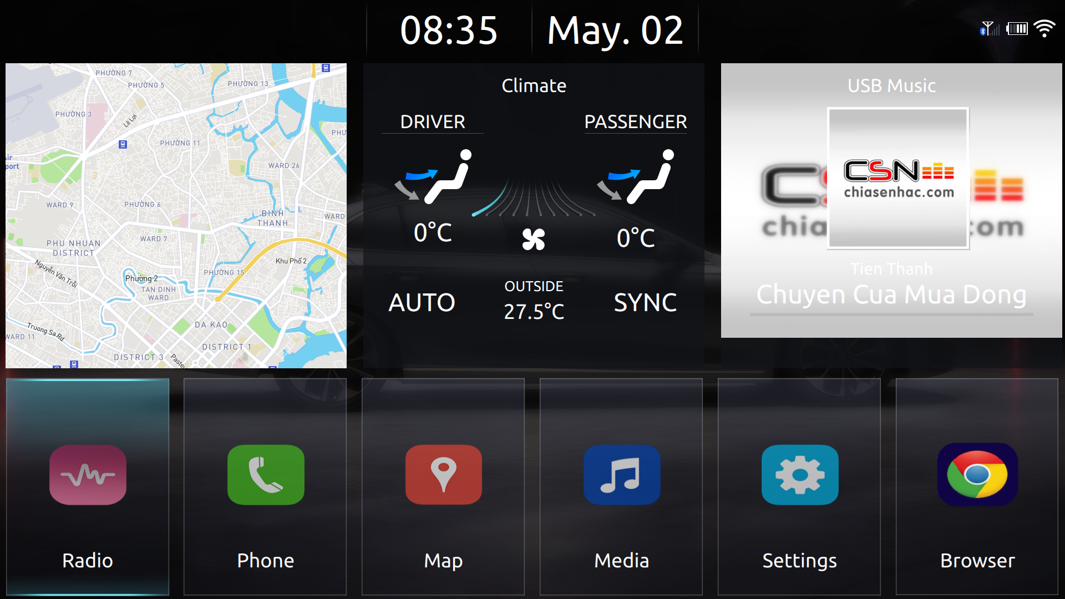
4. User Interface Design

Slide 9
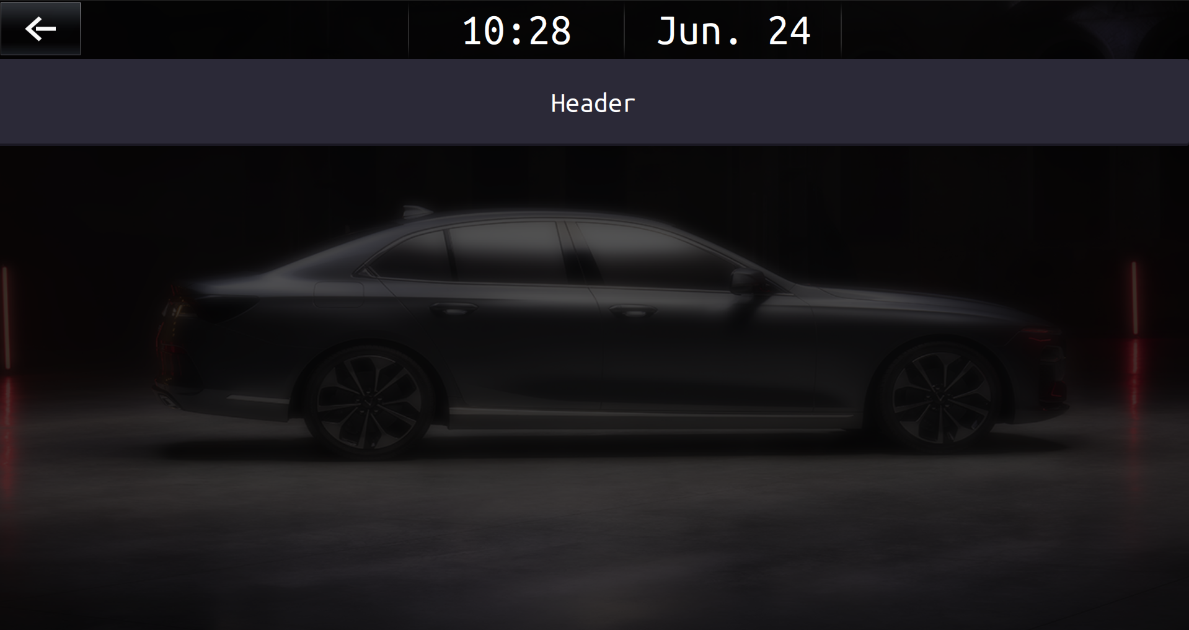
4.1 Other Application
Status Bar area
Header Title
Application Screen

Slide 10
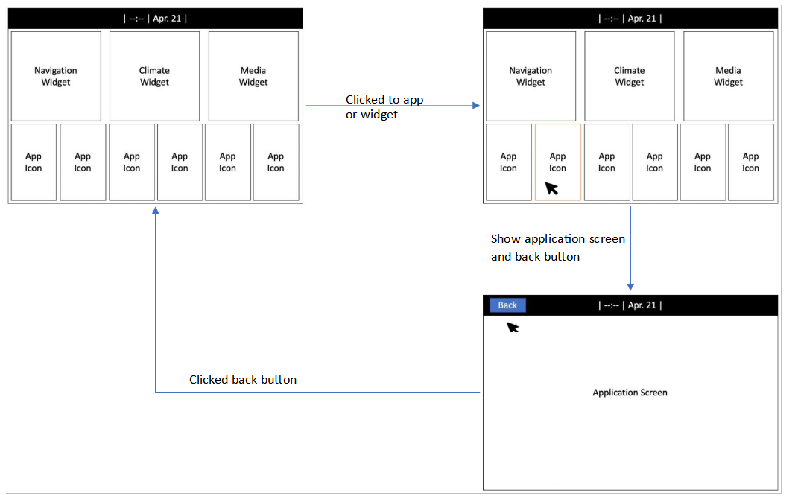
5. Process Flow
Open and close application

Slide 11
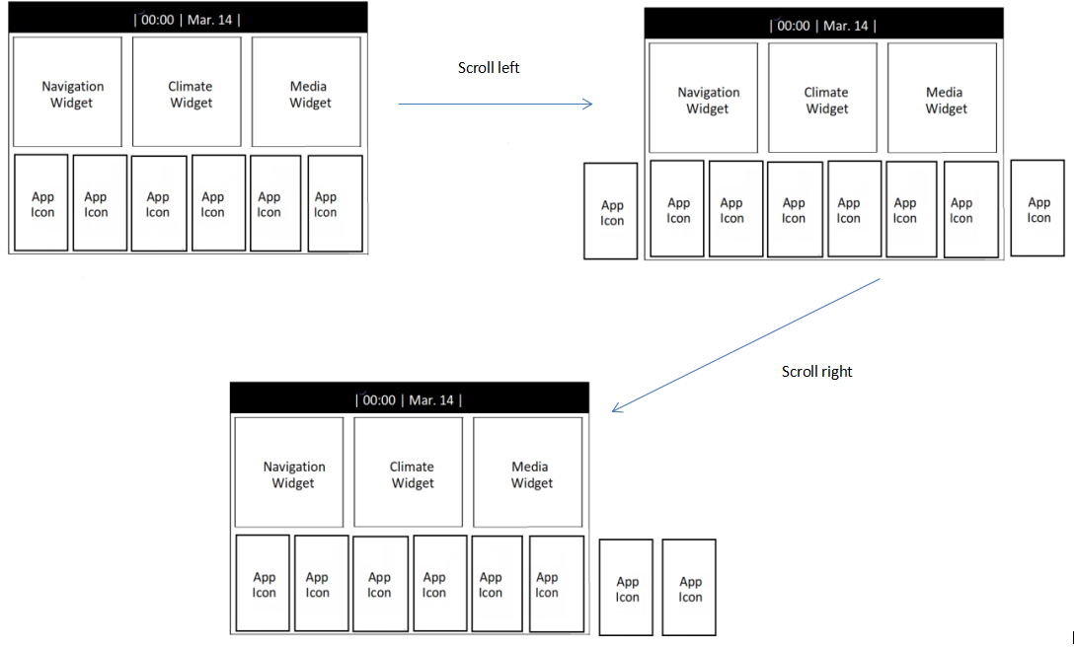
5. Process Flow
Scroll application list

Slide 12
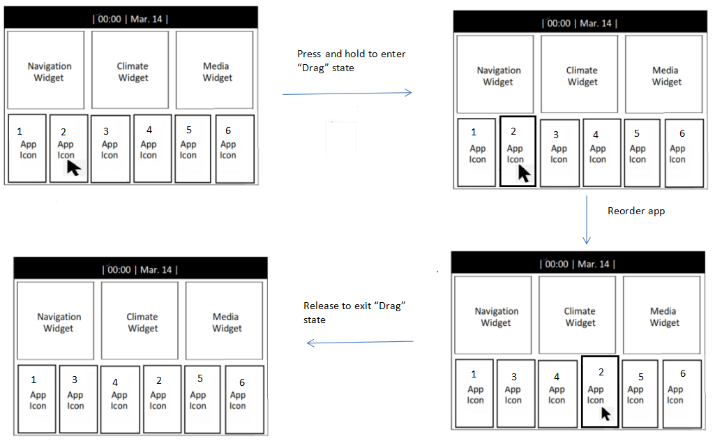
5. Process Flow
Reorder app

Slide 13
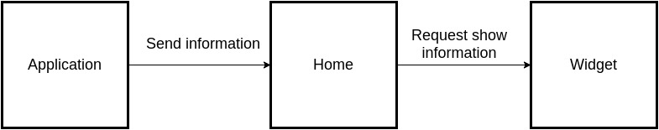
5. Process Flow
Application to widget

Slide 14
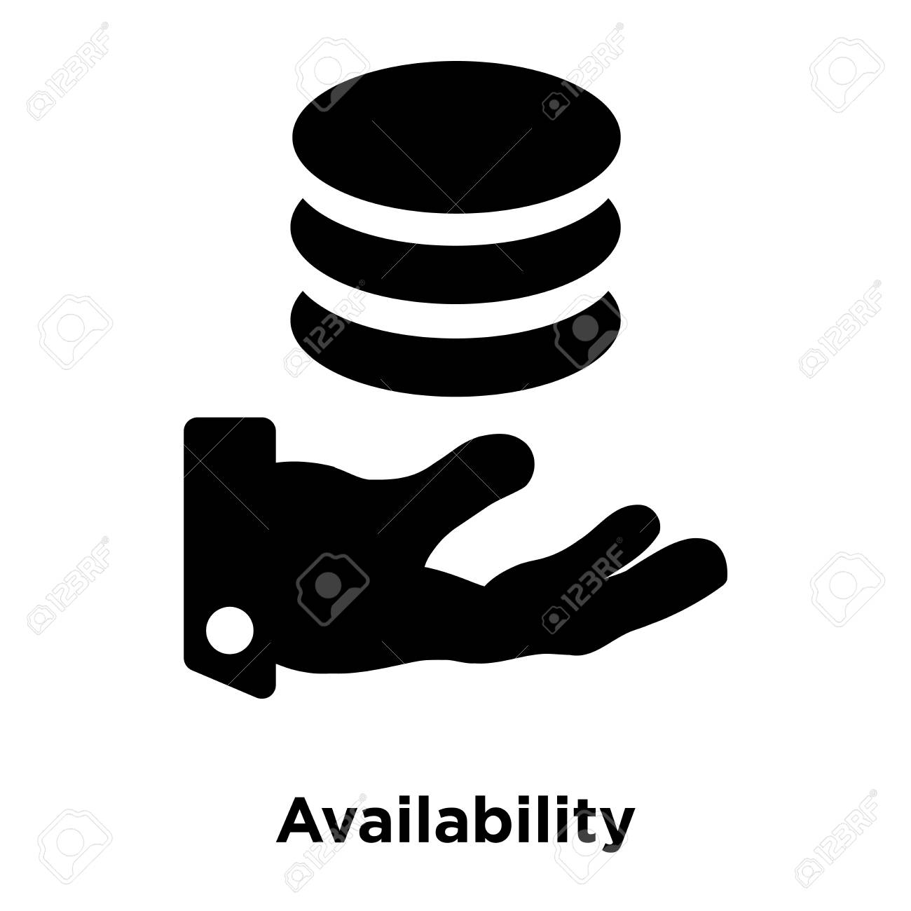
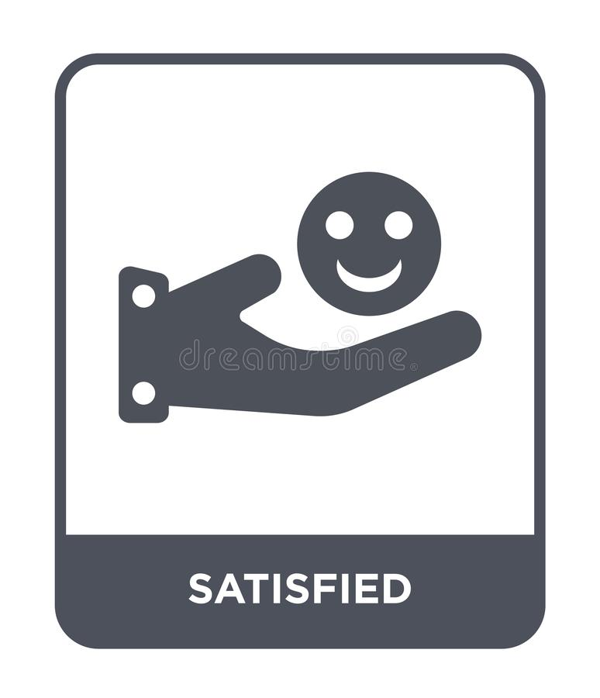
6. Unit Test
Check the vailability of customer’s requirement.
Check if all requirements are satisfied and meet the needs of customers.
Review if any defects or bugs are detected and fixed. Further improvement can be made based on test execution.
Further testing to measure the quality of the application

Slide 15
Refferal
- Qt wiki documentation: https://wiki.qt.io/Main
- Qml documentation: https://doc.qt.io/qt-5/qmlreference.html
- Qt Dbus: https://doc.qt.io/qt-5/qtdbus-index.html
- Dbus example: https://hoangvancong.com/2017/11/24/qt-dbus-qdbus-simple-example/
- MVC model: https://monamedia.co/mvc-la-gi-ung-dung-cua-mo-hinh-mvc-trong-lap-trinh/

Slide 16
7. Demo application
Demo Enviroment:
OS: Ubuntu 20.04 64bit
QT: 5.14.2 64bit

Slide 17
THANK YOU

